Slide 1
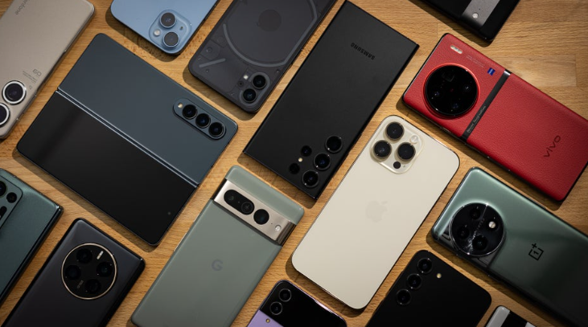
Phone recommendation system
By,
Rushikesh shinde

Slide 2
Table of content
Introduction
Objective
Workflow
Data explanation
Tools and Algorithms used for project
Data Preprocessing
Data Visualization
Data Partition
Model Train and Test Accuracy
Deployment
Challenges in the Project
Advantages
Conclusion

Slide 3
Introduction
Welcome to our recommendation system! In this world of new technology, where various brands launch many phones every month with new or old specifications.
It is very hard task to find best fitting phone for our needs.
this is where the system comes in and to help you choose the write phone for based on the input specifications, eliminates the processes of going through specifications of phones from various brands.

Slide 4
Objective
So, the goal or the objective of this project is to recommend phones based on what specifications people want in their phones.

Slide 5
Work Flow
Data Scraping
Data Transform
Data Load
KMeans
Data Preprocessing
Data Import
LSTM
Class Prediction
Phone Recommendation

Slide 6
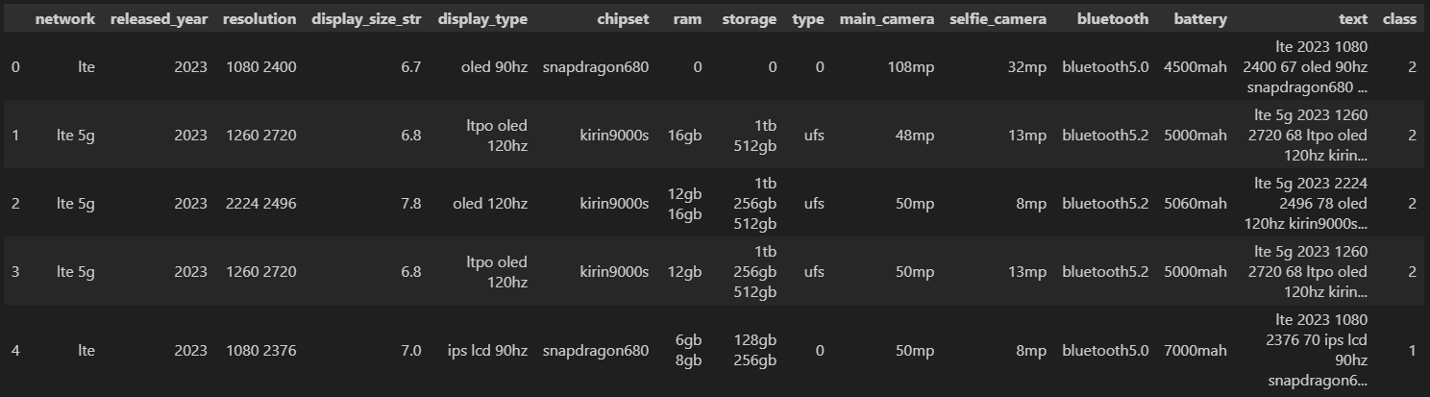
DATASET

Slide 7
Data explanation
Brand: Company of the phone.
Network: Network supported by phone. (In this case we have included only 4g and 5g phones.)
Release year: The year in which phone was released.
Resolution: The resolution of the phone.
Display size: Size of the display.
Display type: type of display OLED, IPS etc....
OS: operating system
Chipset: Processor used in phone.
Ram: Ram configuration offered with phone.
Storage: Storage Configuration offered with phone.
Type: Storage type where is ufs or emmc.
Main camera: The back camera of the phone. (Note only main camera is included in dataset where it may be dual triple or quad setup)
Selfie camera: The back camera of the phone. (Note only main camera is included in dataset where it may be dual setup)
Bluetooth: Bluetooth version.
Battery: Battery capacity.

Slide 8
Tools and Algorithms used for project
Programming Language: Choose Python for its robust NLP libraries.
NLP Libraries: sklearn feature extraction, re.
Machine learning Libraries: Sklearn, NumPy, pandas, matplotlib, seaborn.
Feature Extraction : sklearn feature extraction, sklearn_feature_selection

Slide 9
Data cleaning
Transforming and preprocessing raw text to improve its quality, consistency, and suitability for text mining. Topic modeling, or any other NLP application. Here are some common techniques used for text data cleaning.
Removing special characters and punctuation
Converting to lowercase.
Removing Punctuations.
Removing Common Words.
Tokenization.

Slide 10
Preprocessing and model building
Count Vectorizer
Document Term Matrix
Tokenization
Model Building:
a) KMeans
b) LSTM
c) Cosine Similarity

Slide 11
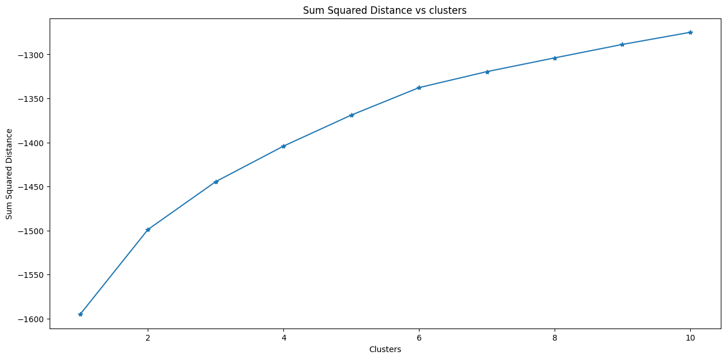
Kmeans Elbow Plot

Slide 12
DATA PARTITION
Test dataset(20%)
Train dataset(80%)
The data partition is done using train_test_split from sklearn library.
80% data is kept in train, whereas 30% is used for test

Slide 13
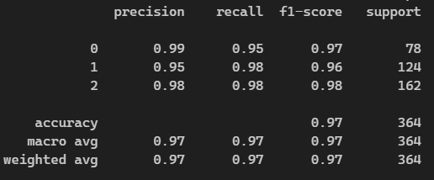
LSTM Model Evaluation

Slide 14
Data Visualization

Slide 15
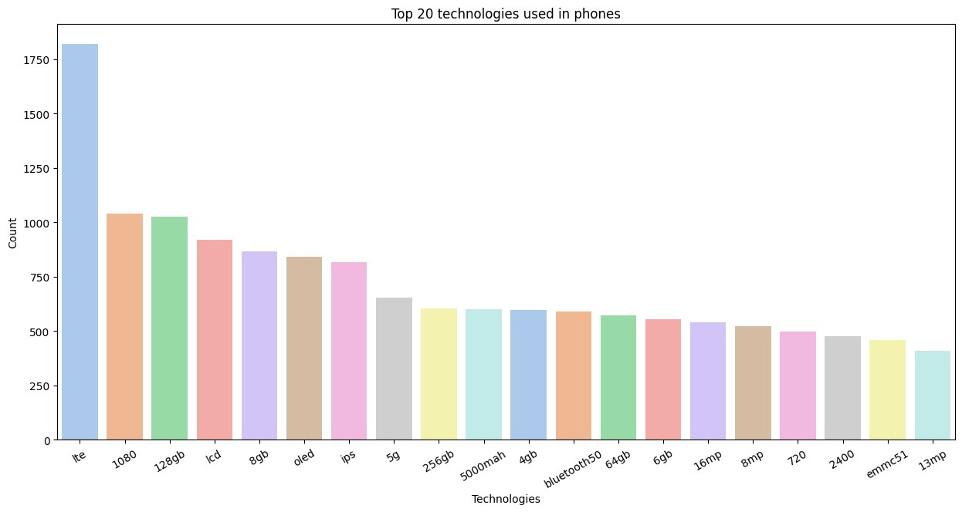

Slide 16
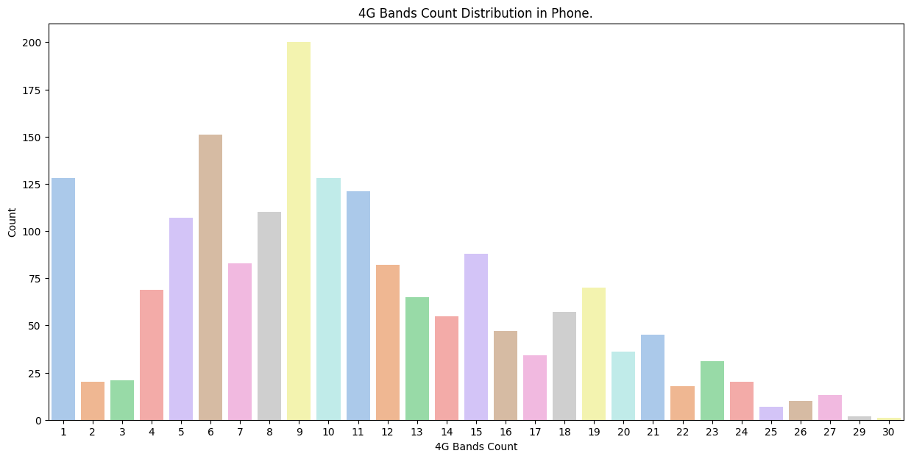

Slide 17
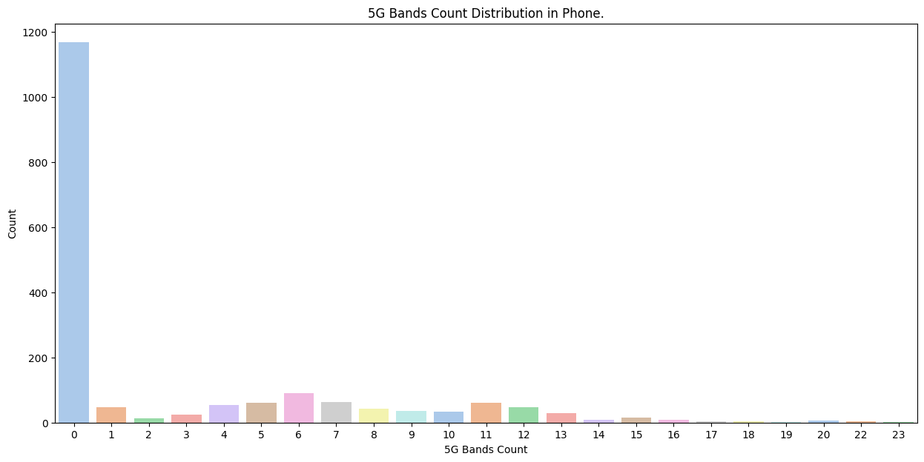

Slide 18
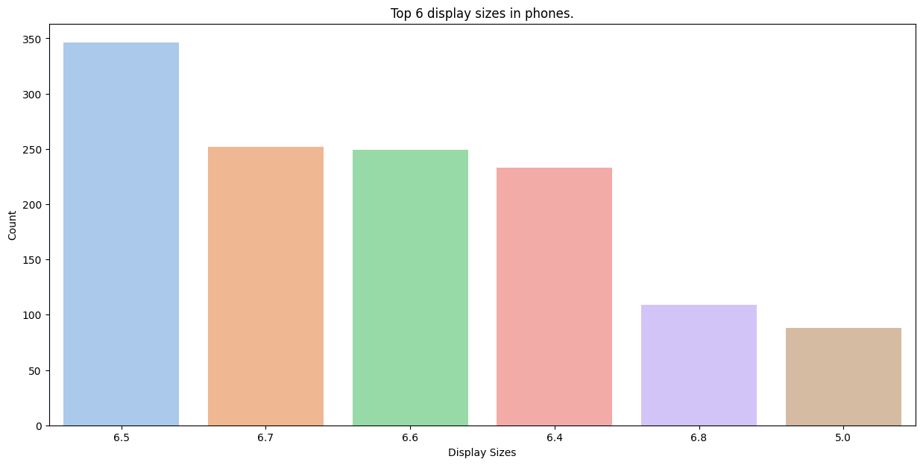

Slide 19
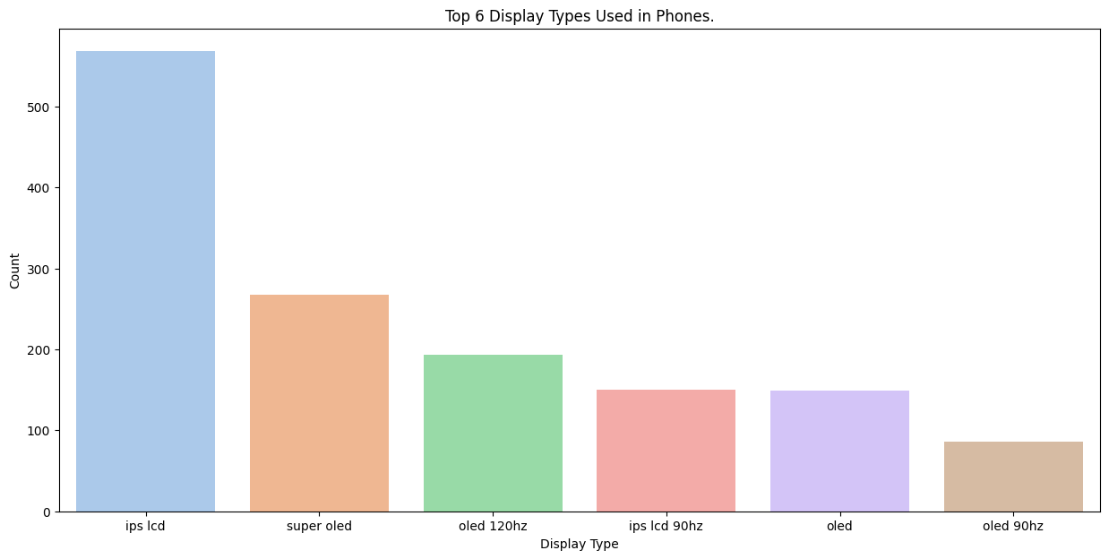

Slide 20
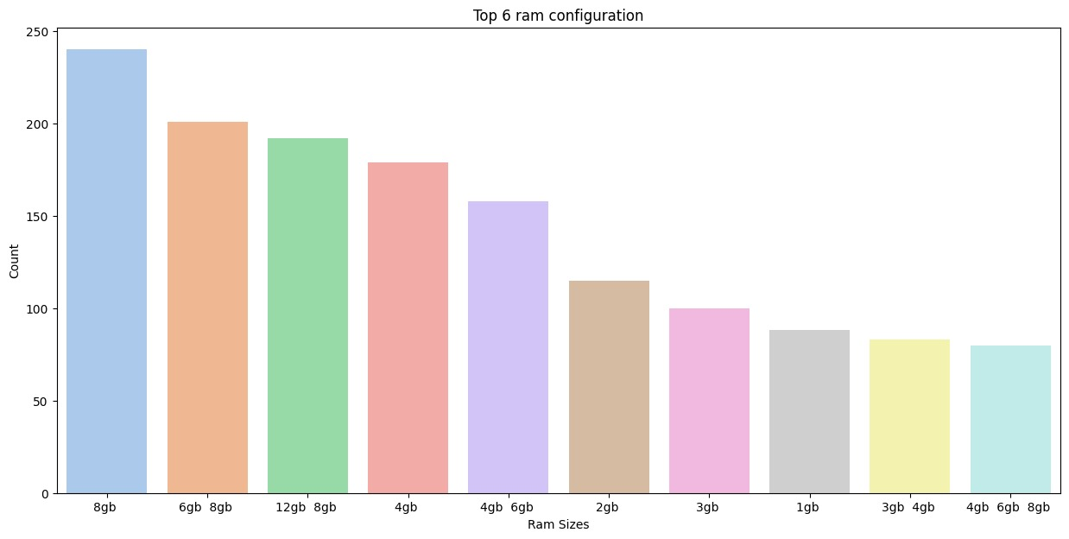

Slide 21
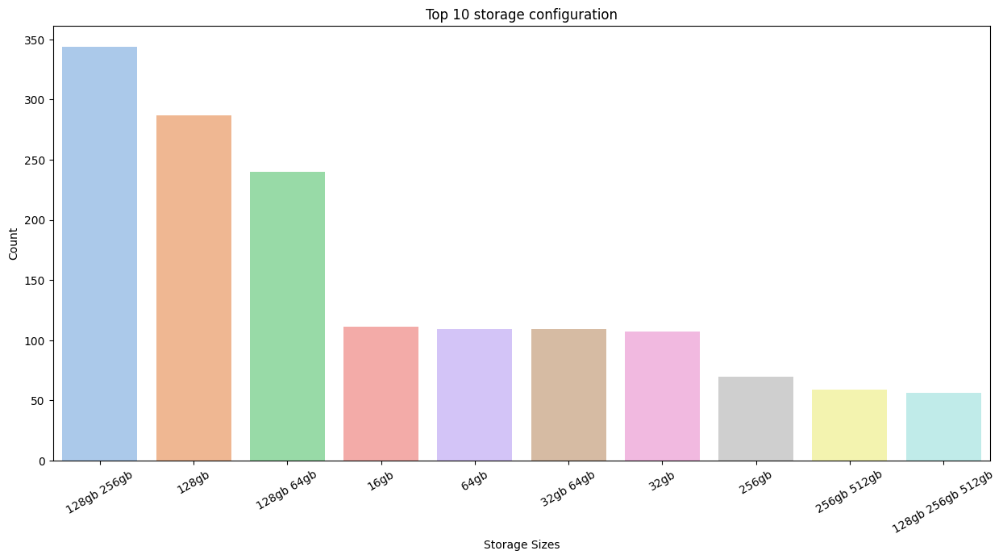

Slide 22
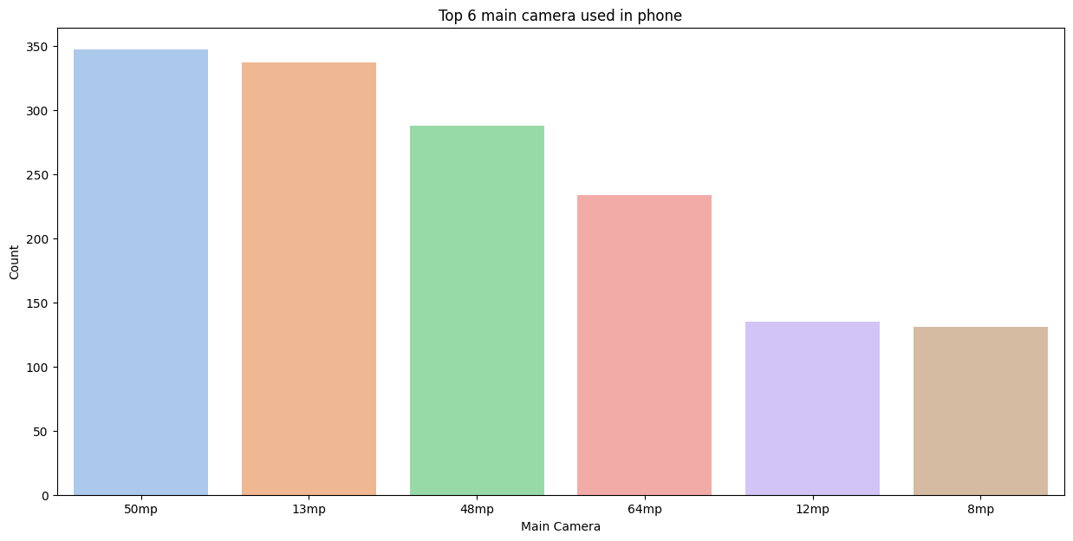

Slide 23
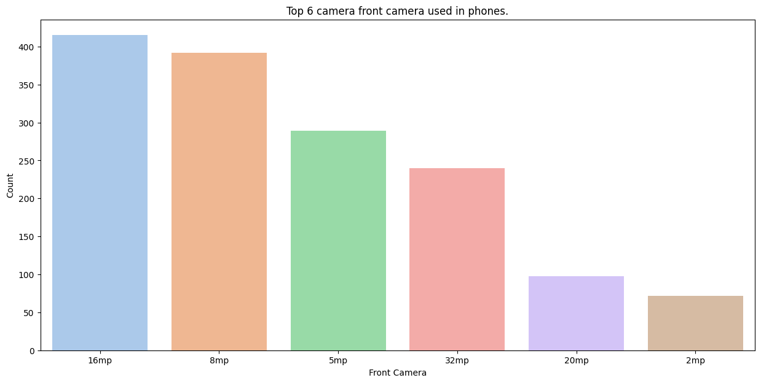

Slide 24
THANK YOU

